Slide 1


Unit 2
Site conditions – cleanliness and safety
Notes:
Welcome to Unit 2 of Module 5.

Slide 2

By the end of this unit, you will be able to:
assess and record the cleanliness and safety conditions at various service sites within a health facility
Notes:
By the end of this unit, you will be able to correctly assess and record the cleanliness and safety conditions at various service sites within a health facility.

Slide 3
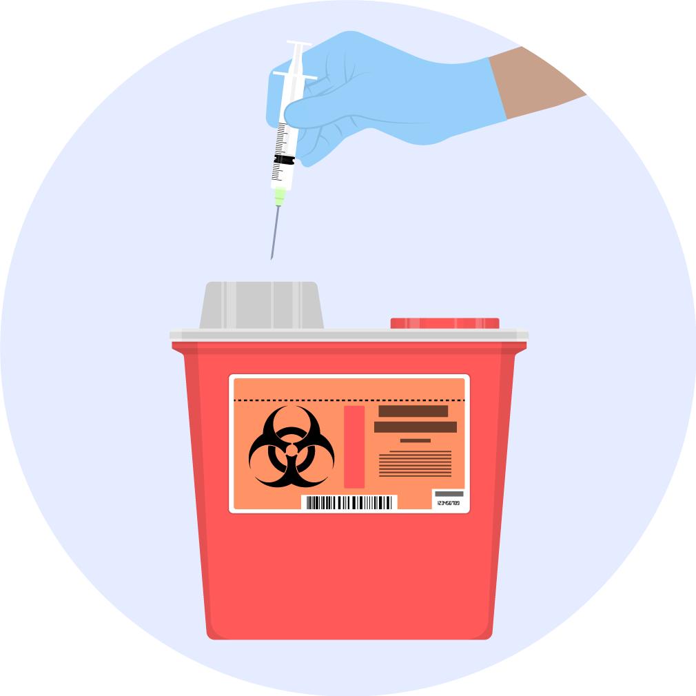

Cleanliness and safety conditions
Data collectors need to conduct a brief observation of actual conditions with regard to cleanliness and safety in multiple service sites.
Notes:
In addition to observing the availability of infection prevention and control items, data collectors will need to conduct a brief observation of actual conditions with regard to cleanliness and safety in multiple service sites.

Slide 4
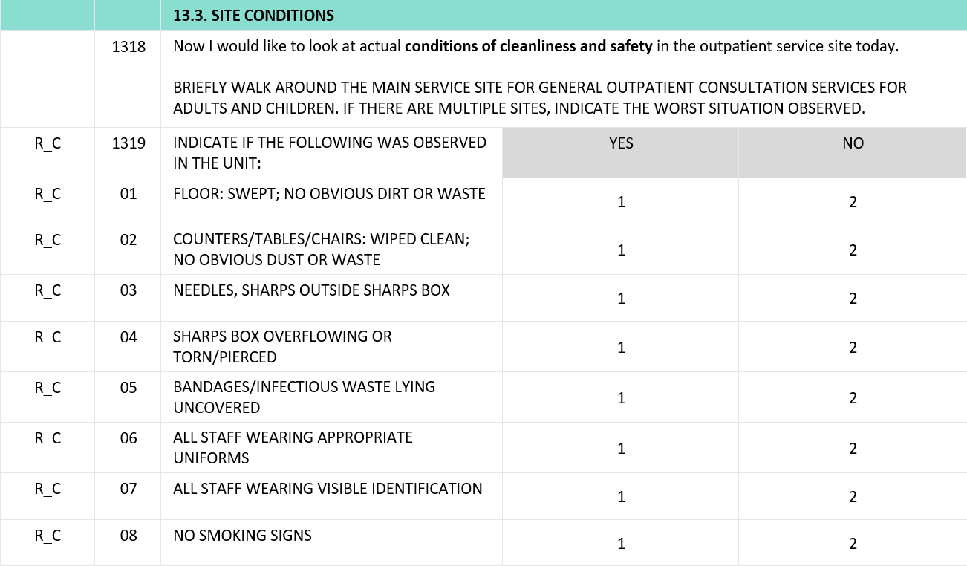
Cleanliness and safety conditions
Capital letters
Instructions to the data collector
Notes:
Let’s look at how these conditions of cleanliness and safety are displayed in the questionnaire.
All the conditions appear in capital letters. This is because they are instructions to the data collector and not questions to the respondent.
As noted in Unit 1 Module 2, instructions to the data collector appear always in capitals.

Slide 5
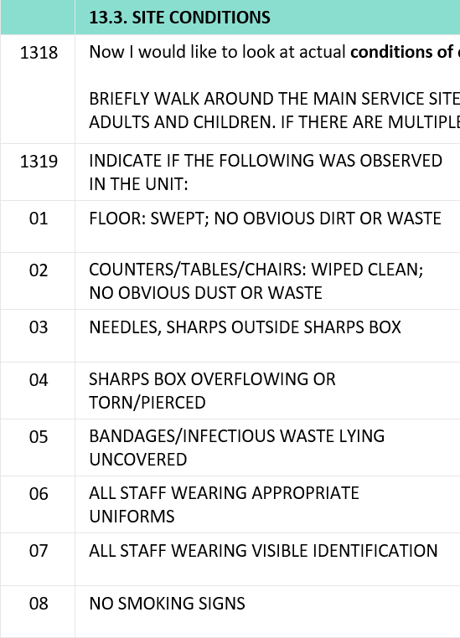
Cleanliness and safety conditions
The list consists of 8 conditions, which are grouped around 5 aspects
Notes:
The list consists of 8 conditions, which are grouped around 5 aspects.

Slide 6

Cleanliness and safety conditions
1
Clean floors and surfaces
This includes conditions 1 and 2.
floor swept
surfaces wiped clean
We want to know if it looks like these areas are routinely kept clean, or if it looks generally neglected.
Notes:
The first aspect is clean floors and surfaces. This includes conditions 1 and 2. The floor of the service area was swept and the surfaces wiped clean with no obvious dirt or waste.
If there are only one or two items on the floor or counters, or a small area that is not swept or not clean, the service area can still be considered clean. We do not want to be too meticulous, but rather, we want to know if overall it looks like these areas are routinely kept clean (despite small problems) or if it looks as if they are generally neglected.

Slide 7
Cleanliness and safety conditions
2
Safe sharps disposal
This includes conditions 3 and 4.
Record if you observe:
any sharp items that are not in a sharps box
sharps in locations where people could injure themselves
Notes:
2. Safe sharps disposal.
This includes conditions 3 and 4.
Record if you observe any used needles or sharp items, such as blades, that are not in a sharps box but that are left on counters, trays, the ground, trash containers, or otherwise in locations where people could inadvertently injure themselves.

Slide 8
Cleanliness and safety conditions
3
Safe contaminated waste disposal
Record if you observe:
bandages with blood / contaminated materials that are not disposed in a waste bin with a liner and lid
Notes:
3. Safe contaminated waste disposal.
Record if you observe bandages with blood or other contaminated materials that are lying around and not disposed in a waste bin with a liner and lid.

Slide 9
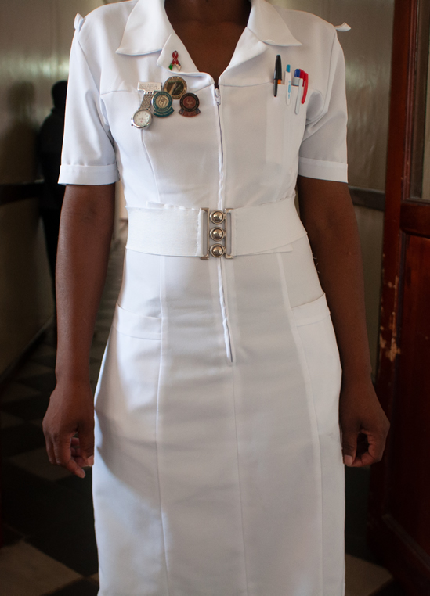
Cleanliness and safety conditions
4
Staff uniforms and identification
This includes conditions 6 and 7.
There is a wide variation of uniforms that are acceptable.
You must note what is accepted in the service area being assessed.
© WHO / Yolanda Barbera
Notes:
4. Staff uniforms and identification.
This includes conditions 6 and 7. There is a wide variation in types of uniforms that are acceptable. You must note what is accepted in the service area being assessed.

Slide 10
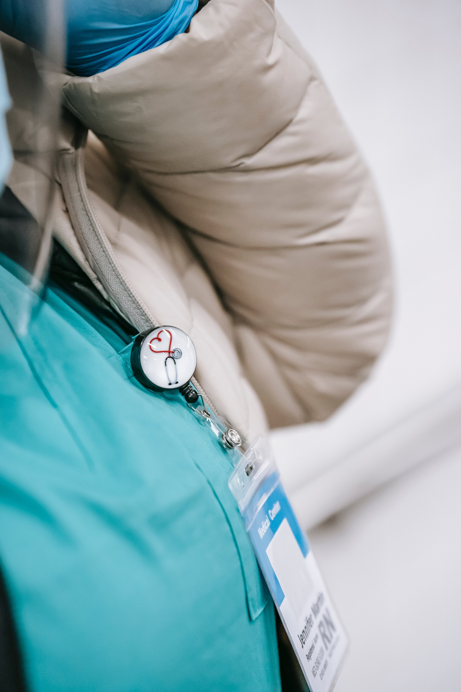
Cleanliness and safety conditions
All facility staff should always wear visible identification.
persons who provide direct patient care should always wear a uniform
physicians usually wear a lab coat
street clothes with a lab coat are not acceptable for uniforms in the surgical or delivery theatre area
staff in surgical area should wear scrubs
Photo by Laura James from Pexels
Notes:
All facility staff should always wear visible identification giving evidence that the person is an authorized employee.
For example:
persons who provide direct patient care should always wear some sort of uniform;
physicians usually wear a lab coat if not wearing scrubs;
street clothes with a lab coat are not acceptable for uniforms in the surgical or delivery theatre area; and
staff should be wearing scrubs to prevent bringing outside germs into surgical theatres.

Slide 11
Cleanliness and safety conditions
5
No smoking signs
Observe whether no smoking signs are present in the service area being assessed.
Notes:
5. No smoking signs.
Observe whether no smoking signs are present in the service area being assessed.

Slide 12
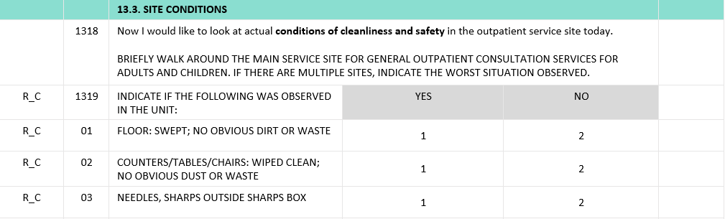
Cleanliness and safety conditions
The following criteria are to be used for classifying the condition being observed:
"1" for “YES” if the condition described in the row was observed
"2" for “NO” if the condition described in the row was NOT observed
Notes:
The following criteria are to be used for classifying the condition being observed:
Select "1" for “YES" if the condition described in the row was observed in the service site;
Select “2” for “NO” if the condition described in the row was NOT observed in the service site.

Slide 13
You have now completed Unit 2.
In the next unit, we will look at data collection on equipment availability and functionality.
Notes:
You have now completed Unit 2.
In the next unit, we will look at data collection on equipment availability and functionality.

